Slide 1
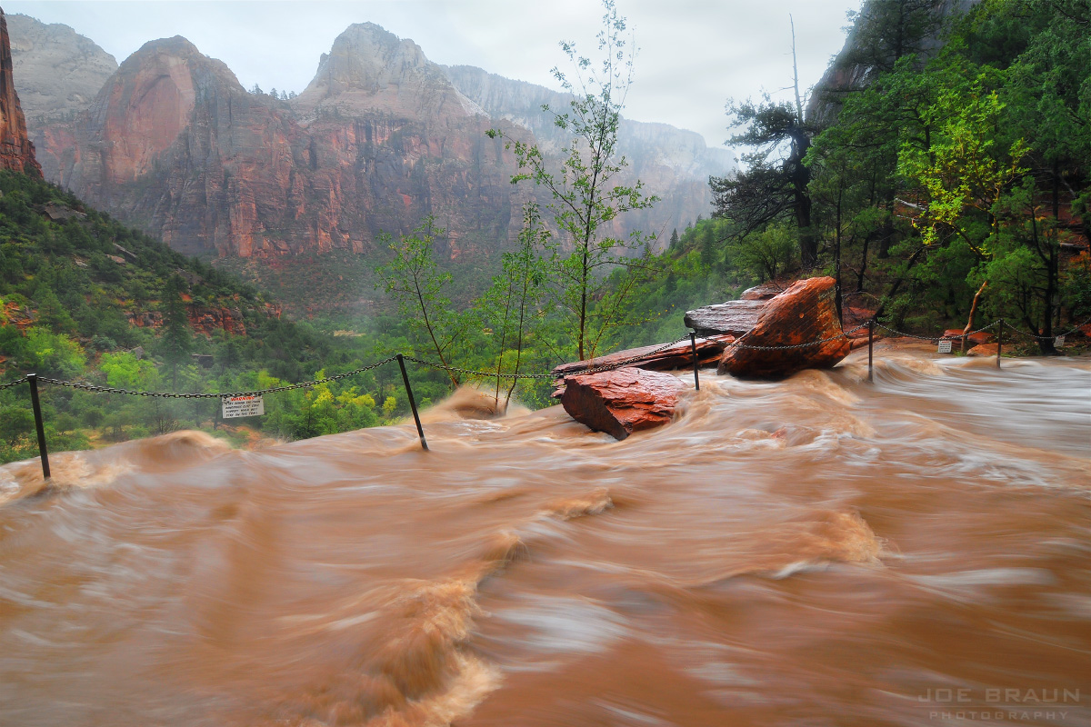
GIS Flash Flood Prediction
Austin Child
11/07/2025

Slide 2
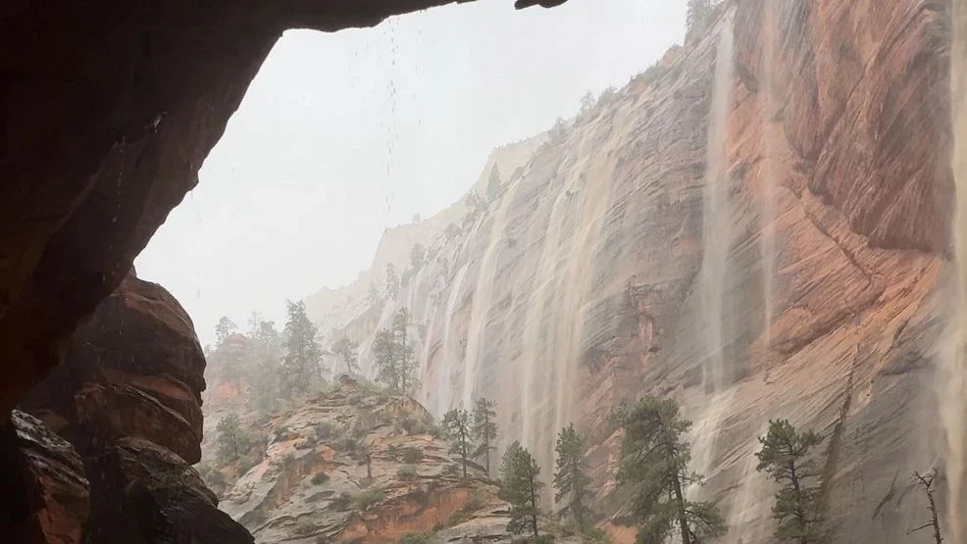
Introduction
Predicting flash flood potential using overland flow models
Southern Utah focused
Provides unique challenges based on terrain
Deliver quick and reliable assessment of flash flood potential

Slide 3
Data Description
Inputs
DEMs from Utah AGRC, USGS
Compiled into one large DEM

Slide 4
Approach
Build a base map
Run hydrologic models (landlab)
Output a raster of flooded canyons

Slide 5
Tool Plan
Inputs:
Output Folder
Extent (Area of interest)
Storm Center
Storm Radius
Storm Duration
Storm Severity
Output
Shape File with flooded canyons highlighted

Slide 6
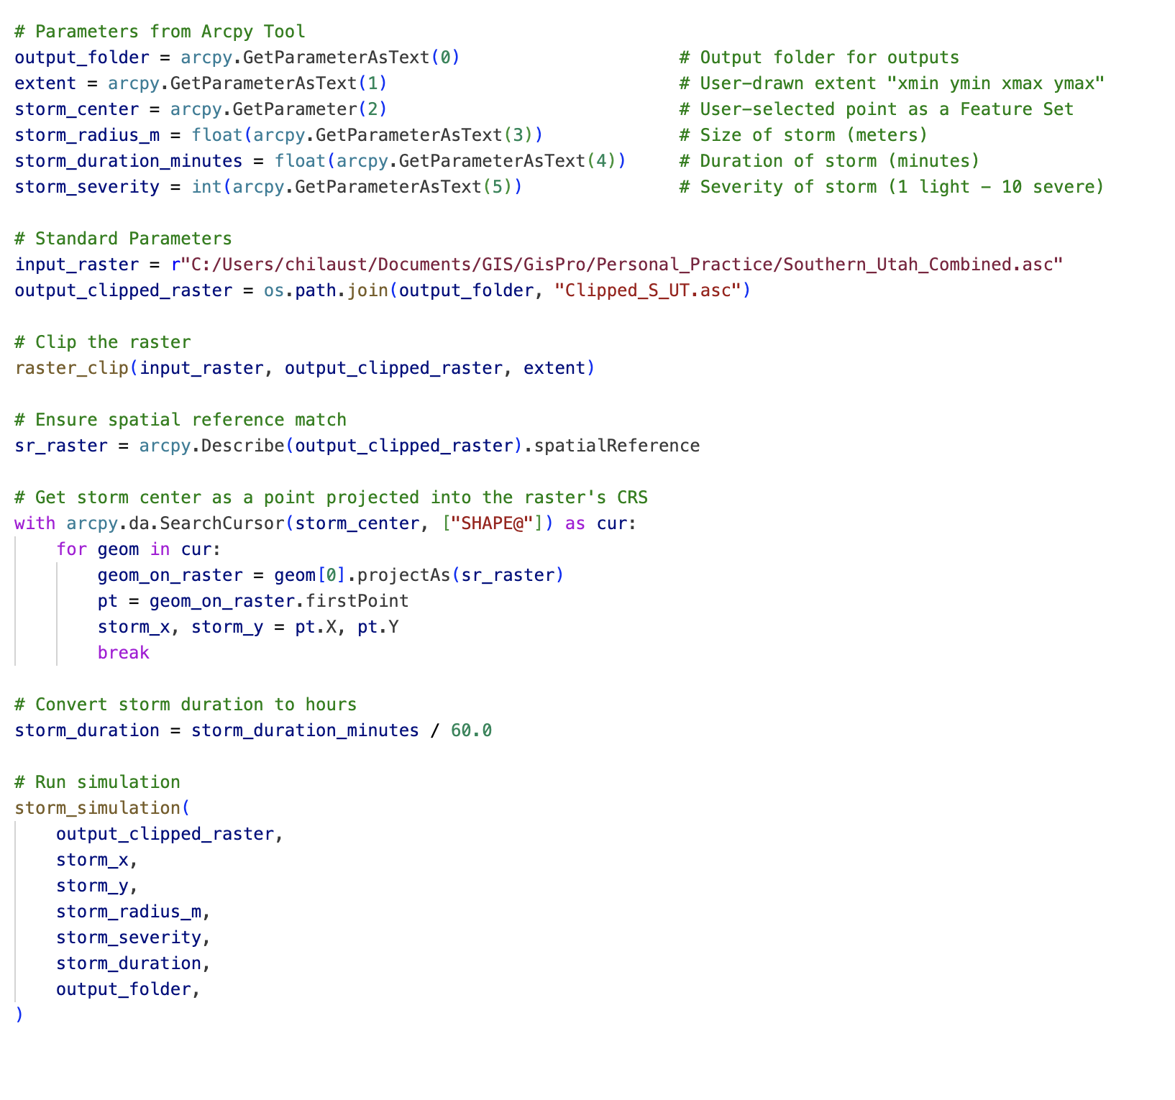

Slide 7
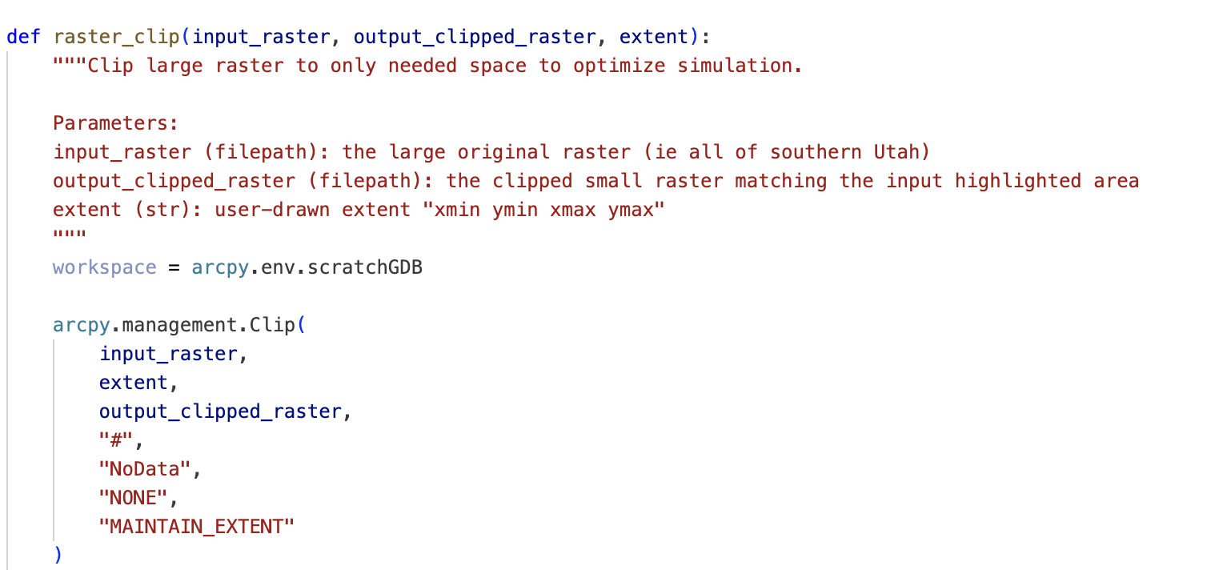

Slide 8
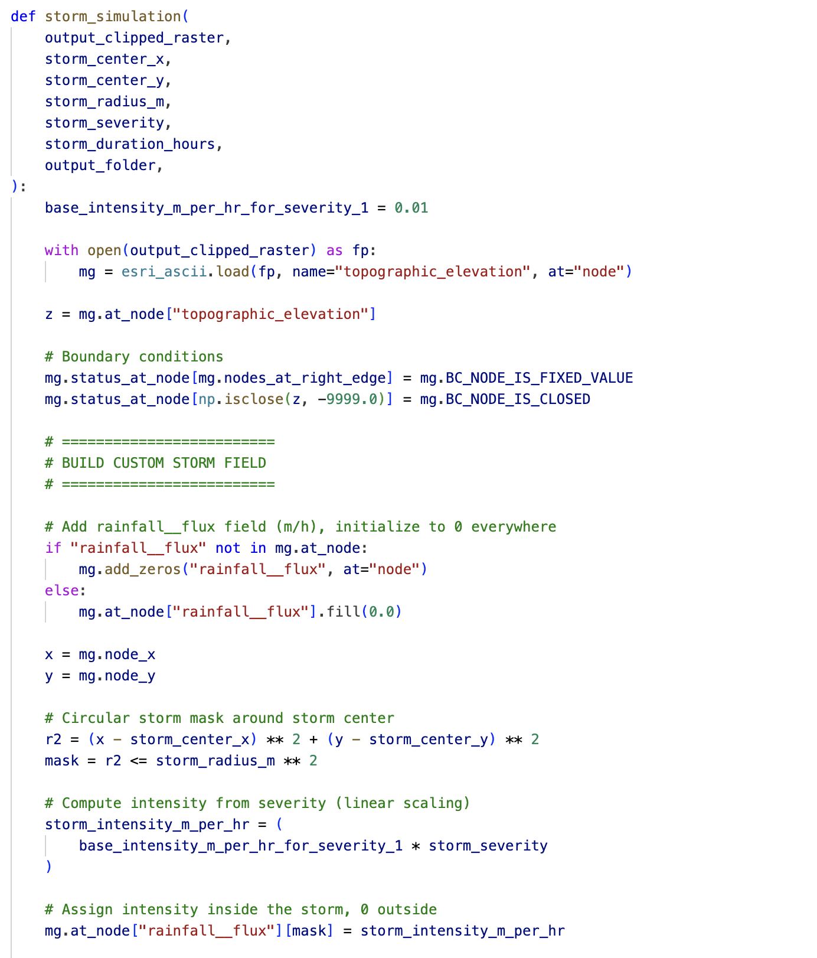

Slide 9
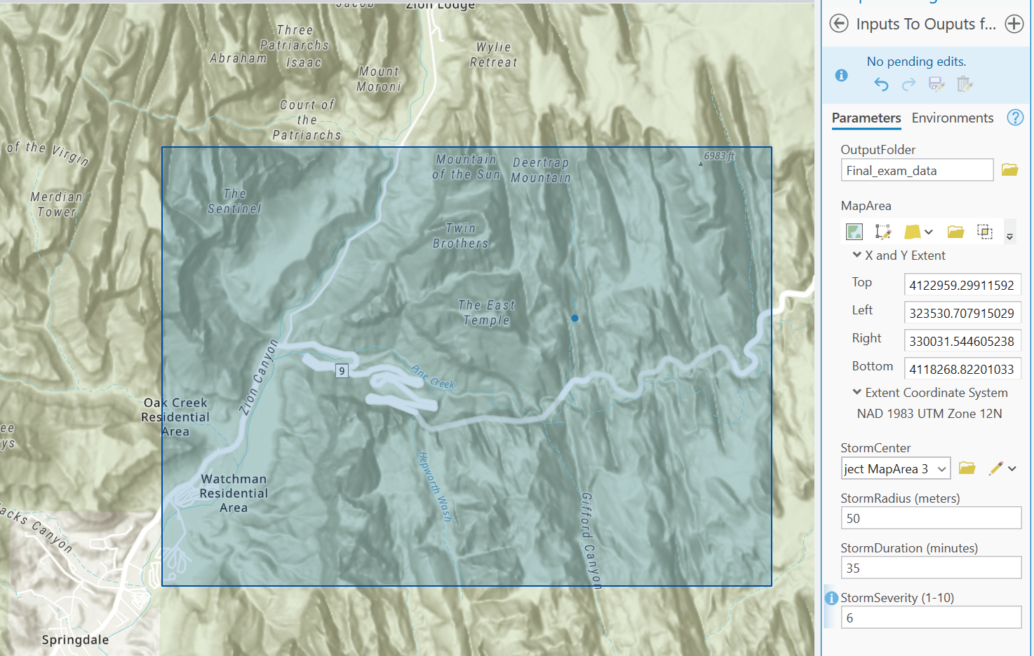

Slide 10


Slide 11
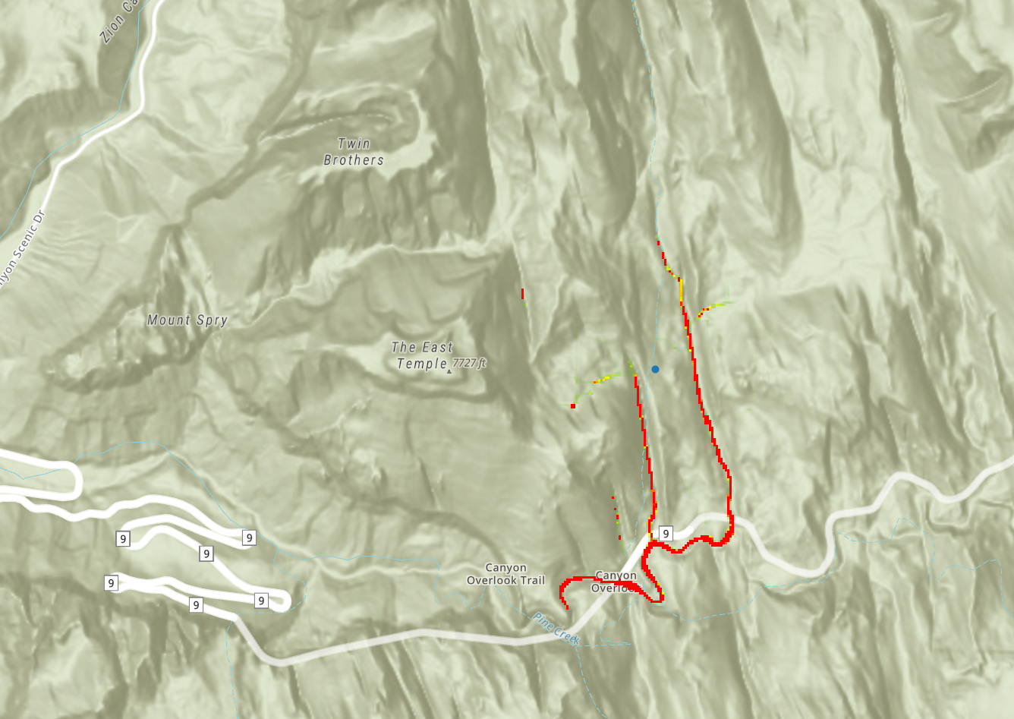

Slide 12
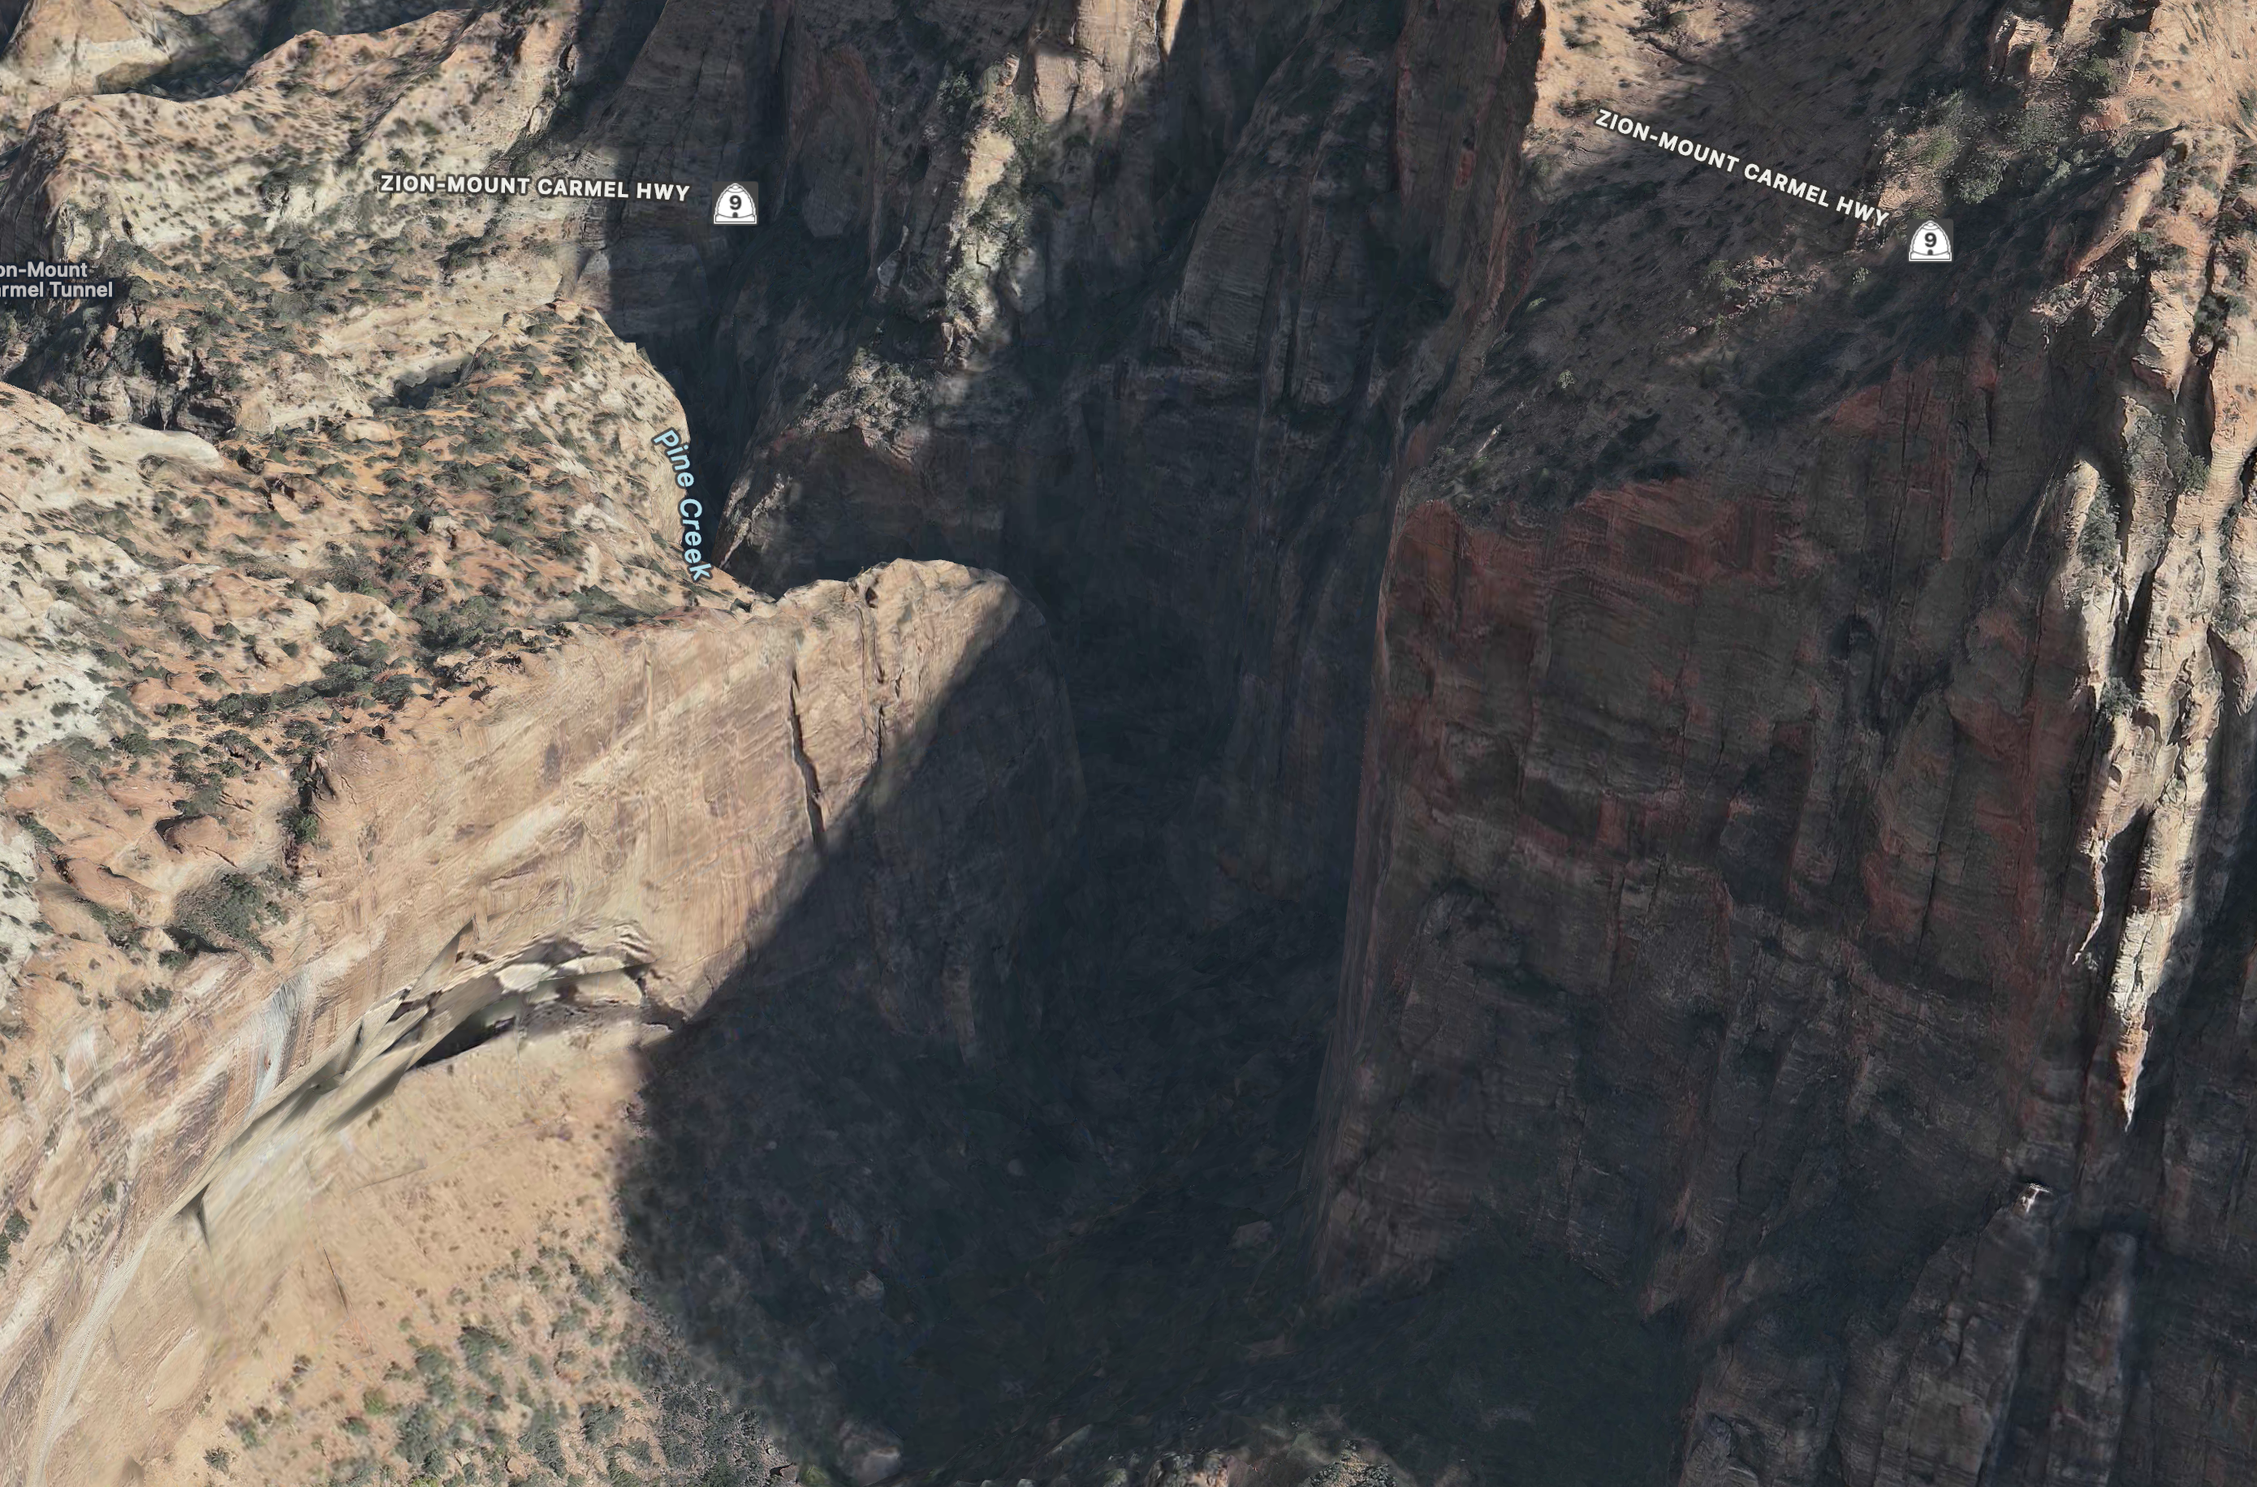

Slide 13
Difficulties
Working with landlab and importing libraries
Coordinating CRS

Slide 14
Future Development
Streamlining workflow
Speeding up processing time
Increasing granularity

